Slide 1
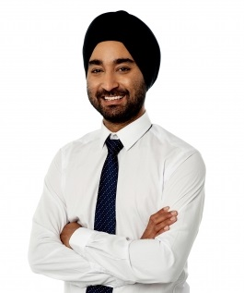
Felix Child or adult with genetic condition Tagline: “I want to be part of a community using an accessible and user-friendly platform” | Goals: I want to use the website to register my genetic condition and view the wider context of my family. I also want to be part of a community and have the opportunity to engage with similar people with the same condition | Frustration and pain points: Currently unable to trace and view scale of genetic condition in family context No organisation which shows interest in genetic condition Most websites are not accessible or user-friendly to engage with
Background (if applicable): | How does Felix want to interact with Fragile X registry website? Access additional resource information, support group details etc. on the site Register their genetic condition in the website Manage their online account as and when required Link their account to family members with the condition and define relationships Generate family tree of the condition

Slide 2
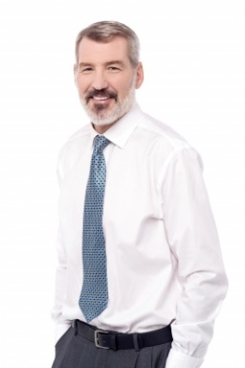
Peter Parent of child with genetic condition. Parent – not a gene carrier Tagline: “I want to engage with research and utilise the benefits of this platform.” | Goals: I want to use the website to register my child’s genetic syndrome and view the wider context of their condition in my family, even though I am not a gene carrier. | Frustration and pain points: Currently unable to trace and view scale of genetic condition in family context Can feel isolated not knowing other families who share the same experiences
Background (if applicable): | How does Peter want to interact with Fragile X registry website? Access additional resource information, support group details etc. on the site Register child with genetic condition in the website Manage child’s online account as and when required Link child’s account to family members with the condition and define relationships Generate family tree of the condition

Slide 3
Jean Family member – gene carrier Tagline: “I want to be part of a community using an accessible platform.” | Goals: I want to use the website to register my family members' and potentially my own genetic syndrome and view the wider context of their and my condition in our family. I want to be part of a community and have the opportunity to engage with similar people with the same condition | Frustration and pain points: Currently unable to trace and view scale of genetic condition in family context As member of family is a gene carrier, there could be accessibility frustrations and pain points in using the website
Background (if applicable): | How does Jean want to interact with Fragile X registry website? Access additional resource information, support group details etc. on the site Child registration: Register child with genetic condition in the website Manage child’s online account as and when required Link child’s account to family members with the condition and define relationships Generate family tree of the condition Family member registration: Register their own genetic condition in the website Manage their own online account as and when required Link their own account to family members with the condition and define relationships Generate family tree of the condition

Slide 4
Una Member of family who has not been tested for genetic condition Tagline: “I want to engage with the registry website, even though my condition is unclear.” | Goals: I want to engage with the Centre for Clinical Brain Sciences and the community through the website, even though my condition is unclear. | Frustration and pain points: Uncertainty about how to secure assurance regarding personal condition Uncertainty about whether to submit a theoretical questionnaire
Background (if applicable): | How does Una want to interact with Fragile X registry website? Access additional resource information, support group details etc. on the site Engage with the Centre for Clinical Brain Sciences for support Register their genetic condition in the website (potentially) Manage their online account as and when required Link their account to family members with the condition and define relationships Generate family tree of the condition

Slide 5
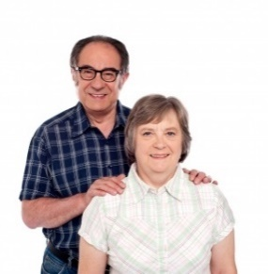
Claire Carer for an someone with genetic condition, who is a non-family member Tagline: “I want a support the person I care for within the confines of the support arrangement.” | Goals: I want to support the person I care for register their an account on the website whilst maintaining the appropriate levels of professional care. | Frustration and pain points: Professional boundary regarding how much information should be shared The feasibility/ expectation of managing and maintaining their online account in the long term
Background (if applicable): | How does Claire want to interact with Fragile X registry website? Access additional resource information, support group details etc. on the site Register an adult with genetic condition in the website Manage adult’s online account as and when required Link adult’s account to family members with the condition and define relationships Generate family tree of the condition

Slide 6

Angela Staff based in Centre for Clinical Brain Sciences Tagline: “I want a user-friendly system which will support me carry out operational and strategic objectives of research programme.” | Goals: I want to effectively manage and maintain the registry of genetic conditions, ensuring all information contained is relevant and up-to-date. Useful site to advertise genetic condition support groups or agencies. | Frustration and pain points: Duplicate work effort to complete task(s)/ Lack of automation Complex or challenging interface to use Limitations to create bespoke reports/ surveys
Background (if applicable): | How does Angela want to interact with Fragile X registry website? Advertise additional resource information, support group details etc. on the site Register a new account of someone with a genetic condition. This information could be provided by the individual themselves/ family member/ carer over the telephone or via email Add additional information to user accounts Manage and maintain active user accounts, including changing details and removing users Send targeted surveys to any cohort of registered users within the site Generate standard or create bespoke reports from the site Export user data from the system Online contact tool to respond to general queries from research staff or interested parties

Slide 7
Vicky Someone who wants to help a researcher – control group Tagline: “I want to support a researcher or control group achieve their strategic objectives” | Goals: I want to support the a known researcher or control group achieve their strategic objectives. In order to achieve this, data will need to be exported for analysis, interpretation and testing. | Frustration and pain points: No central facility to request data for research purposes Limited clear guidelines about the types of information which can be shared
Background (if applicable): | How does Vicky want to interact with Fragile X registry website? Access additional resource information, support group details etc. on the site Submit freedom of information (FOI) requests to Centre for Clinical Brain Sciences for response, seeking certain data for research purposes

Slide 8

Richard A genetic condition researcher Tagline: “I want to conduct research into genetic conditions, using the most accurate and relevant data.” | Goals: I want to complete specialist research into genetic conditions to achieve their strategic objectives. In order to achieve this, data will need to be exported for analysis, interpretation and testing. | Frustration and pain points: No central facility to request data for research purposes Limited clear guidelines about the types of information which can be shared
Background (if applicable): | How does Richard want to interact with Fragile X registry website? Access additional resource information, support group details etc. on the site Submit freedom of information (FOI) requests to Centre for Clinical Brain Sciences for response, seeking certain data for research purposes

Slide 9

Gloria Caldicott Guardian Tagline: “I want a reliable and secure platform which is fully compliant with the relevant security and accessibility requirements.” | Goals: Accountable to the Lothian Board to ensure research is conducted in line with the compliance and data security protocols set. Accountable to ensure the registry website meets the relevant equality and impact requirements in terms of accessibility. | Frustration and pain points: Data is relevant and up-to-date, showing clearly any patterns or trends the governing board monitors
Background (if applicable): | How does Gloria want to interact with Fragile X registry website? Will have no direct or formal access with the registry website, other than the public view The Centre for Clinical Brain Sciences will engage with the Caldicott Guardian, using the registry website to pull required reporting for their governing body Ultimately accountable to ensure registry website meets the relevant DPIA, EIA and security standards set by the governing body

Slide 10

Steve Security expert for ISG Tagline: “I want a reliable and secure platform that can pre-empt and withstand any known or unknown potential threats to data security.” | Goals: A secure, reliable and proactive platform which can withstand any potential threat to data security. Once implemented, the site will be managed by ISG, Production Management team who will provide 1st and 2nd line technical support for any issues logged by end users or the Centre for Clinical Brain Sciences administrative team. | Frustration and pain points: Continuously evolving new methods hackers will attack the data security of platforms Security flaws within the platform security due to lack of due diligence regarding DPIA and security requirements
Background (if applicable): | How does Steve want to interact with Fragile X registry website? Responsible to ensure registry website meets the relevant DPIA, EIA and security standards set by project team Responsible to ensure the platform is able to withstand both known and unknown security hacks

Slide 11
Dave Technical developer Tagline: “I want a reliable and secure platform that can pre-empt and withstand any known or unknown potential threats to data security.” | Goals: A secure, reliable and proactive platform which can withstand any potential threat to data security. Once implemented, the site will be managed by ISG, Production Management team who will provide 1st and 2nd line technical support for any issues logged by end users or the Centre for Clinical Brain Sciences administrative team. | Frustration and pain points: Continuously evolving new methods hackers will attack the data security of platforms Security flaws within the platform security due to lack of due diligence regarding DPIA and security requirements
Background (if applicable): | How does Dave want to interact with Fragile X registry website? Responsible to ensure the technology complies with the information security requirements specified by the internal security SME, project team and Centre for Clinical Brain Sciences

