Slide 1
BI MI Programme

Slide 2
BI MI Programme
Overview
The basic objectives of the programme is to better information provision and provide a consistent reporting capability.
The programme is the continuation of the work to foster an ongoing BI capability, with a three year budget outlined under the Digital Transformation portfolio. The budget is largely committed to funding a dedicated team to produce reporting from HR and finance strategic DataMart's.
Whilst the programme has a wide brief, the initial priority for the team is a high level discovery and analysis project for users whose data universes are being decommissioned in HR & Finance.

Slide 3
BI MI Programme
Governance
Establish a Programme Board / Steering Group to monitor and guide the programme.
Initiate projects as required
Identify key stakeholders in the BI Governance Structure (Slide 4)
Using SEP for HR and Finance and Gasp MI Analyst engagement models for effective stakeholder management business requirements
Deliver a Communications Plan

Slide 4
UoE BI & Data Governance Structure
University Committees
University Executive
Approve
policy
University Court
Approve
policy
Senate
Working Groups
Community Groups
Service Excellence Programme
Knowledge Strategy Committee
(University Standing Committee)
Recommend
policy
Service Excellence Programme Board
Information Technology Committee
(University Thematic Committee)
BI/MI Governance Board (KSC Sub-group)
Recommend
policy
Recommend
policy
Digital Transformation Board
Service Excellence Design Authority
College IT Committees
BI Steering Group
BI/MI Programme Board
Data Governance Group
API Steering Group
Information Security WG
College CPAGs
API prioritisation
Advise on policy
Advise on policy
BI Community
Strategic Planning Network
Data Stewards Community of Practice
Federated Data Working Sub-Groups
Consumers
Suppliers

Slide 5
BI MI Programme
Approach
Agree Vision & Goals
Understand why people need to use HR and Finance data and identify what data, how this is defined, seeking agreement on data definitions and how to join HR & Finance data together and dimensional modelling
Develop the required HR & Finance DataMart's
Define what data is to be brought in and how it is to be defined
Develop a high-level plan and roadmap with timescales for implementation of strategic reporting and analytics for HR and Finance

Slide 6
BI MI Programme
BI Team
Resourcing
IS Apps is resourcing the programme with a dedicated team using fixed term appointments and/or backfilling seconded roles.
Development Team
Business Information Knowledge
BI Solution Architecture
BI Backend Development
BI Report Development
BI Testing
Database Expertise
Product Owner
Programme Management
Skills on Request
Security & Authorisation
Source Skills
User Experience
Vendor Specific Tools

Slide 7
BI MI Programme
Scope
Dedicated team tasked to produce strategic reporting from HR and Finance strategic DataMart's
Discovery and Analysis Project for HR & Finance
This high level analysis project focuses tasks on the Core systems currently in place whose DataMart's are being decommissioned with HR and Finance. Outputs include:
Requirements analysis
Data analysis of source systems
High level implementation plan
Verify the data warehouse architecture and approach foundation layer etc.
Out of Scope
Any other data warehouse development. Responsive BI Service Development. Student, Applicant or Research data. Historic data stores

Slide 8
BI MI Programme
Funding
Funding & Budget; The funding bids for this work were originally split into a ‘BI Responsive Service’ and ‘Key Strategic Information’ bid. Broadly helps to delineate the new ongoing Service Management costs to run the tools and applications that will be created (effectively a permanent ongoing cost to maintain the new offerings); from the desire to fund some ongoing work to bring in key areas of information, allowing us create meaningful BI outputs without seeking sponsor funding. Therefore the funding streams have been combined and are treated jointly for the practical management of the programme. At a later stage an indication will need to be given of the likely ongoing permanent commitment needed to continue running the service and responding to small changes.
Ongoing Funding Requirements - Seek reassurances from ISC and through university planning processes that the ongoing costs will be met

Slide 9
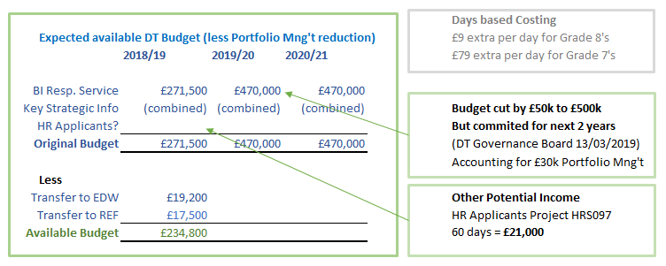
BI MI Programme
BI MI Budget

Slide 10
BI MI Programme Benefits Map
To be completed

Slide 11
BI MI Programme
Risks
Alignment with core systems migration work
Expectations Around BI MI Deliverables
SME Design & Testing
Ongoing Funding
Service & Production Management Support Model
IS Resource Contention
Recruitment Challenges
Hypergeneralised Data Model
Budget Under Utilisation
Scope Change
Key People Single Points of Failure

Slide 12
BI MI Programme
Plan
Broadly what’s going to be happening over 3 monthly chunks.
What are the major milestones being achieved/major progress?
HR dates?
Finance dates - early & late ?
Bedding in periods?
Hooking up new data feeds matching old with new connections when?
Four blobs on a timeline should do it.
Old one on next slide but could be much simpler.

Slide 13
BI MI Programme Plan
Programme Business Case
31/5/19
Stakeholder Analysis Workshop
Collections as Data - Analysis Output
12/2/19
13/6/19
Initiate first tranche
First Programme Board Meeting
Digitisation - Analysis Output
9/12/18
15/2/19
20/6/19
Oct
Nov
Dec
2019
Feb
Mar
Apr
May
Jun
Jul
Aug
2019
Today
1/10/18
Scope & Define Business Analysis Requirments - Digitisation
1/2/19
2018
1/10/18
Scope & Define BA Requirements - Collections as Data
1/2/19
26/10/18
Compile Vision and Objetives
21/12/18
5/12/18
Est. Prog. Team
18/1/19
11/12/18
Business Analysis - Digitisation (DLIB001)
31/5/19
123 days
18/12/18
Business Analysis - Collection as Data (DLIB002)
27/6/19
124 days
1/4/19
Review Exist. Dig. Scholar.Tools
31/5/19
57 days
3/6/19
Develop service level tools
30/8/19
45 days
31/5/19
Website Workstream
15/8/19
171 days
28/2/19
Define Benefits
26/4/19
192 days
18/2/19
Engage. Plan
29/3/19
61 days
28/2/19
Blueprint
26/4/19
89 days
1/10/18
Define Programme
29/3/19
77 days
27/06/19
Coll. as Data Proj. - TBD
15/08/19
58 days
31/5/19
Digitisation Project - TBD
15/8/19
40 days
58 days
180 days
50 days
77 days
Notes:
Kirsty – do you want to talk to the plan?

