Slide 1
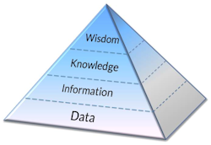
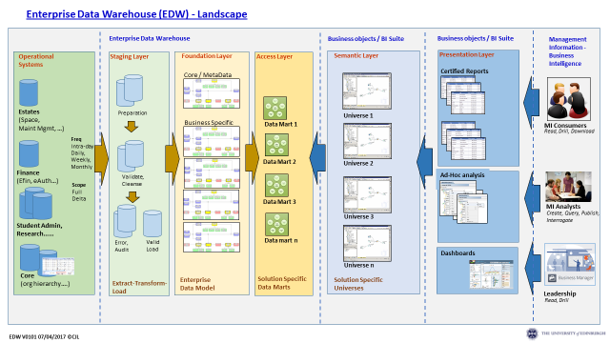

Vision for the Enterprise Data Warehouse (EDW) Programme
“Deliver the strategic data that enables evidence-based decision-making across the University”
We’ll do this by:
Providing a scalable and secure data storage platform which is based on external best practice and leverages class leading technologies
Delivering a service for the consistent and automated extraction and translation of data from source systems
Supporting secure and scalable access to data from our BI tools
Delivering a complete, holistic solution which enables University staff and students to fully leverage this strategic investment
V0106 07/11/2017

