Slide 1


CESAR OLL’s New Administration Platform
DEMO - Part 1

Slide 2

Overview
How do we deliver change?
What have we done to date?
What have we planed to do by October?

Slide 3


User Stories Backlog
Your Ideas

Slide 4


Product Backlog Prioritisation
Project Team

Slide 5
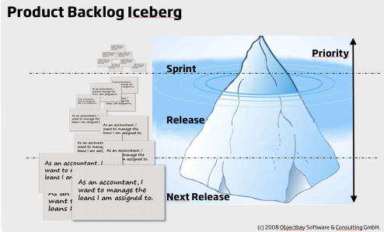
Product Backlog Prioritisation
Minimum Viable Product:
Security
Course Maintenance
Student Account Maintenance and Registration
Tutor Account
Enrolments & Unenrolments
Finance
OLLIE Book
Reports

Slide 6



Frequency of Use Low [-------------------------------♦-------] High
Urgency (deadlines, answering enquiries) Low [-------------------------------------♦-] High
More or Less Features Less [-------------------------------♦------] More
Level of Access Low [--------------------♦------------------] High
Course vs. Student focused C [----♦----------------------------------] S
Course Secretary
Frequency of Use Low [-------------------------------------♦-] High
Urgency (deadlines, answering enquiries) Low [-------------------------------------♦-] High
More or Less Features Less [-------------------♦------------------] More
Level of Access Low [-------♦-------------------------------] High
Course vs. Student focused C [---------------------------------♦-----] S
Registration

Slide 7
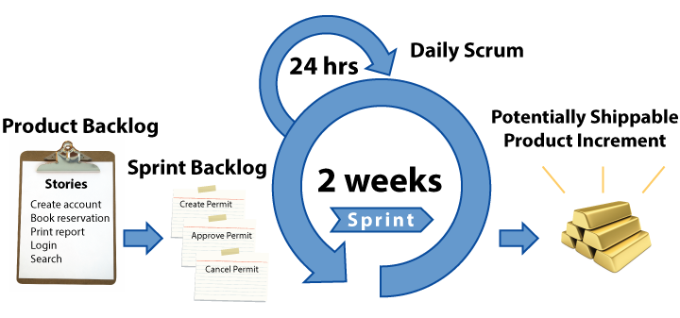
MVP Product Development
Release of new features

Slide 8


Course Maintenance – Add Course
As a … Course Secretary
I want to… add a new Course
So that… I can create instances of that course for online/offline booking
As a … Course Organiser
I want to… be able to view course details
So that… I know the course details are correct

Slide 9

Course Maintenance – Add Course
User Story reference | Summary | Status
HSS001-5 | Add course | Done
HSS001-6 | Edit course | Done
HSS001-103 | Add course code to course | Done
HSS001-46 | View course (Dashboard) | Done

Slide 10
Course Maintenance – Add Course Instance
As a … Course Secretary
I want to… create a course instance
So that… the course instance is available for registering customers
As a … Course Secretary
I want to… be able to delete a course instance if I've made too many mistakes and want to start again; or it is no longer relevant (limited conditions)
So that… I know the course details are correct

Slide 11
Course Maintenance – Add Course Instance
User Story reference | Summary | Status
HSS001-11 | Add course instance | Done
HSS001-14 | Delete course instance | Done
HSS001-48 | View course instance (Dashboard) | Done

Slide 12
Course Maintenance – Add Classes
As a … Course Secretary
I want to… add a number of classes in one action
So that… there is a quick way for me to create multiple classes
As a … Course Secretary
I want to… to be able to add additional class instances to an existing course instance
So that… I can extend a course instance if necessary

Slide 13
Course Maintenance – Add Classes
User Story reference | Summary | Status
HSS001-19 | Bulk add class instances | Done
HSS001-20 | Add single class instance | Done
HSS001-22 | Edit class instance | Done
HSS001-125 | View Class Instance (Dashboard) | Done

Slide 14
Student Account Maintenance and Registration
As a … Registration
I want to… to create and maintain a student account
So that… I can input new students as they enrol in person or over the phone

Slide 15
Student Account Maintenance and Registration
User Story reference | Summary | Status
HSS001-40 | Create and maintain Student account | Done
HSS001-70 | View student account (dashboard) | Done

Slide 16
Enrolments and Unenrolments
As a … Registration Officer
I want to… to enrol a student on a course, capturing all the necessary details
So that… I can secure a place for that student

Slide 17
Enrolments and Unenrolments
User Story reference | Summary | Status
HSS001-50 | Create a manual enrolment (from Student account view) | Done
HSS001-139 | Link Student number in Instance/ Enrolment to Student's dashboard | Done

Slide 18
Tutor Account Maintenance
As a … As an HR Officer
I want to… to create and maintain a tutor account for every tutor delivering courses at OLL
So that… I can maintain a database of all of our tutors with up-to-date information, plus my colleagues can assign tutors to course instances.

Slide 19
Tutor Account Maintenance
Tutor Account Maintenance
User Story reference | Summary | Status
HSS001-105 | Create and maintain a (basic) tutor account | Done

Slide 20
Search Courses, Instances and Students
As a … CESAR user
I want to… to search courses by keyword, session offered, title, subject and code
So that… I can see what courses are available
As a … Registration Team / Student Support Officer
I want to…be able to search for student accounts by last name, first name, email or student code
So that… I can find a student record

Slide 21
Search Courses, Instances and Students
User Story reference | Summary | Status
HSS001-17 | Search courses | Done
HSS001-18 | Search course instances | Done
HSS001-71 | Search for student account | Done

Slide 22

What have we planed to do by October?

Slide 23
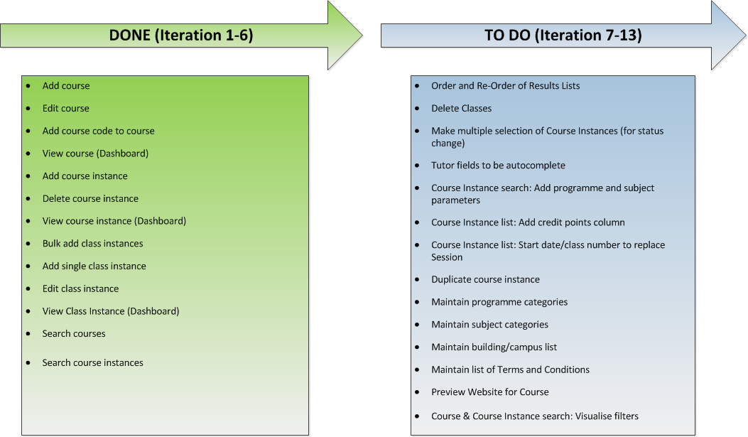
Course Maintenance

Slide 24
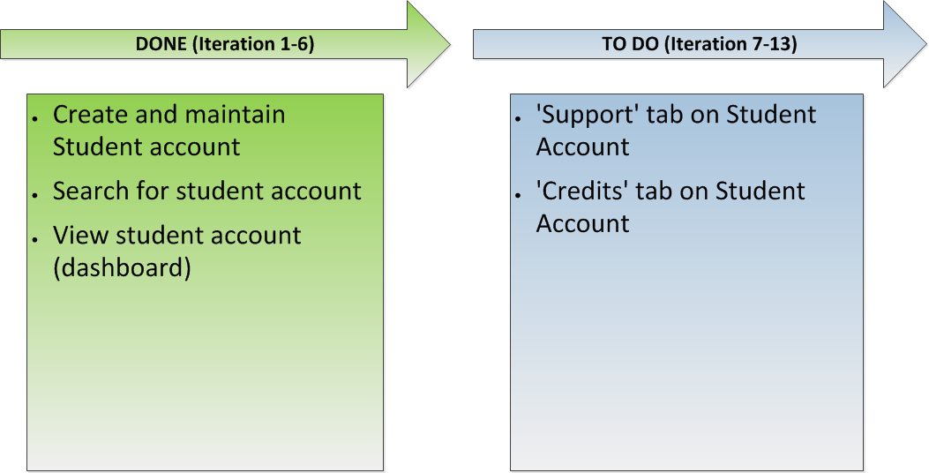
Student Account Maintenance and Registration

Slide 25
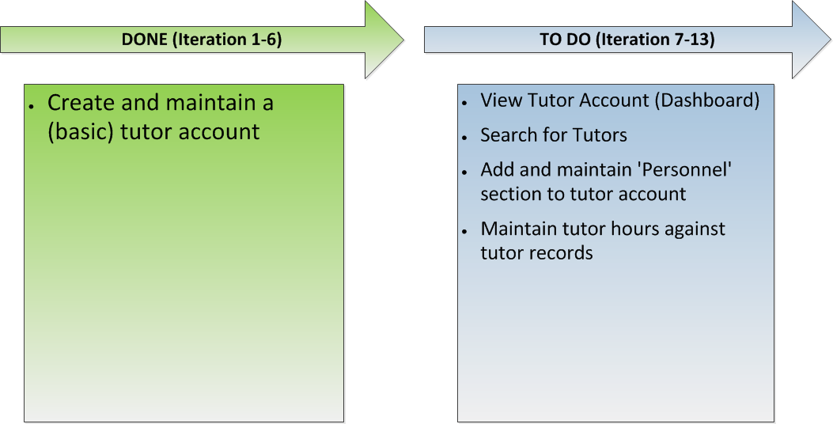
Tutor Account Maintenance
Tutor Account Maintenance

Slide 26
Enrolments and Unenrolments

Slide 27
Finance

Slide 28
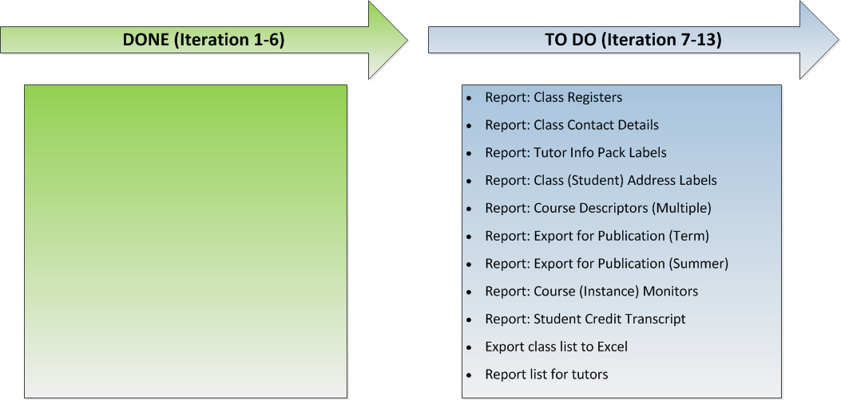
Reports

Slide 29
OLLIE Book

Slide 30
What is next?
UX Testing
User Acceptance Testing
Transition Planning

Slide 31

Questions ??

